Slide 1

Computer graphics libraries and frameworks
Lecturer : Tanaboon Tongbuasirilai
Course : ICCS404
Week 1 : Introduction to Computer Graphics

Slide 2
functionality
Low-Level vs. High-Level Libraries
Low-level libraries provide direct control over hardware functionalities, offering fine-grained control but requiring a deeper understanding of graphics programming. High-level libraries offer a more user-friendly interface, often built on top of low-level libraries, and handle many complexities internally.
2D vs. 3D Graphics
Some libraries specialize in 2D graphics manipulation (e.g., image processing, UI rendering), while others focus on 3D graphics tasks (e.g., 3D modeling, animation, rendering).
Specific Tasks
Certain libraries cater to specific tasks within computer graphics, such as image processing (e.g., OpenCV), user interface development (e.g., Qt), or scientific visualization (e.g., VTK).
Notes:
Rendering Focus:
2D Graphics Libraries: These libraries specialize in manipulating and rendering two-dimensional visuals. Common tasks include image processing (e.g., resizing, filtering), user interface (UI) element creation, and 2D game development. (Examples: SDL, SFML, Cairo)
3D Graphics Libraries: These libraries focus on creating and manipulating 3D objects, scenes, and rendering them into 2D images. They handle tasks like 3D modeling, animation, lighting, and material properties. (Examples: OpenGL, Vulkan, DirectX)
Specialized Functionality:
Image Processing Libraries: These libraries offer a wide range of functions for image manipulation, including filtering, noise reduction, feature extraction, and object recognition. (Examples: OpenCV, scikit-image)
Scientific Visualization Libraries: These libraries specialize in creating visual representations of scientific data, often used in scientific computing and simulations. (Examples: VTK, ParaView)
User Interface (UI) Development Libraries: These libraries provide tools for building graphical user interfaces, including buttons, menus, and other interactive elements. (Examples: Qt, GTK+, wxWidgets)
Game Development Libraries: These libraries offer a comprehensive set of functionalities specifically designed for building video games, including physics simulation, collision detection, and sound management. (Examples: Unity, Unreal Engine, Godot Engine)

Slide 3
API (Application Programming Interface)
Graphics APIs
These are low-level APIs that provide direct access to graphics hardware functionalities, like OpenGL or DirectX. They offer the most fine-grained control over rendering processes. However, they require a deep understanding of graphics programming concepts.
Shading Languages
These are languages used to program shaders, which control how objects are rendered on the screen (e.g., GLSL, HLSL). Shading languages are often used in conjunction with low-level graphics APIs.

Slide 4
Libraries vs frameworks
Graphics Libraries:
Focus - Provide a collection of pre-written functions and tools for specific graphics tasks.
Level of Control - Offer low-level to mid-level control over graphics functionalities.
Examples - OpenGL, DirectX, SDL
Use Cases
Implementing core graphics rendering tasks (drawing shapes, textures, etc.)
Building custom graphics pipelines
Interacting with specific graphics hardware features
Graphics Frameworks:
Focus - Provide a comprehensive set of tools and functionalities for building entire graphics applications.
Level of Control - Offer a higher-level abstraction, often built on top of graphics libraries. Developers have less control over the underlying details but gain access to pre-built components and functionalities.
Examples - Unity, Unreal Engine, Godot Engine
Use Cases
Rapid development of games and other interactive 3D applications
Utilizing pre-built components like physics engines, animation tools, and asset management
Creating complex graphical user interfaces (GUIs)

Slide 5

Low-level graphics APIs

Slide 6
opengl
OpenGL (Open Graphics Library) is a widely used cross-language, cross-platform application programming interface (API) for creating 2D and 3D vector graphics. In simpler terms, it's a set of instructions that allows programmers to tell the computer's graphics card (GPU) how to draw things on the screen. Here are some key points about OpenGL
Efficiency - It leverages the GPU for faster rendering of graphics, leading to smoother animations and more visually complex scenes.
Versatility - It's not limited to a specific programming language or operating system, making it adaptable for various development environments.
Low-Level Control - Compared to some graphics frameworks, OpenGL provides a more fine-grained level of control over the graphics rendering process. This flexibility allows for customization but also requires a deeper understanding of graphics programming concepts.

Slide 7
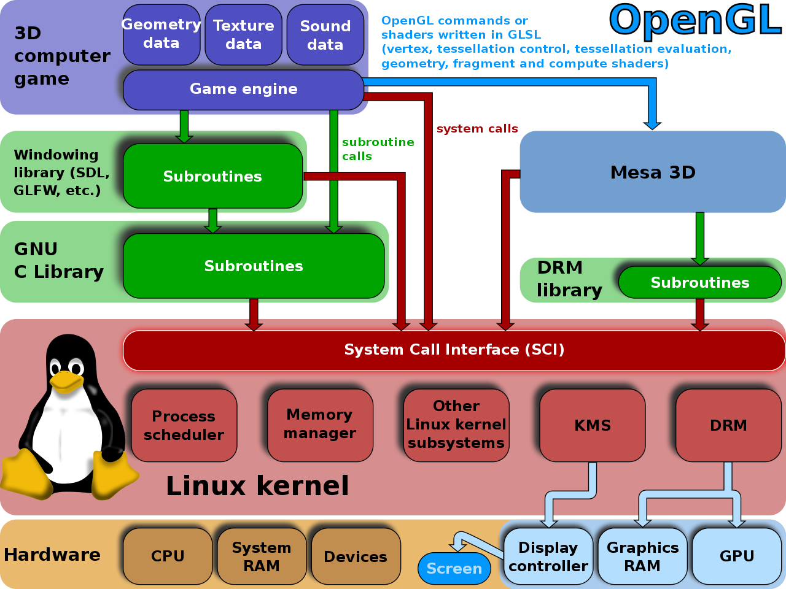
How OpenGL works

Slide 8
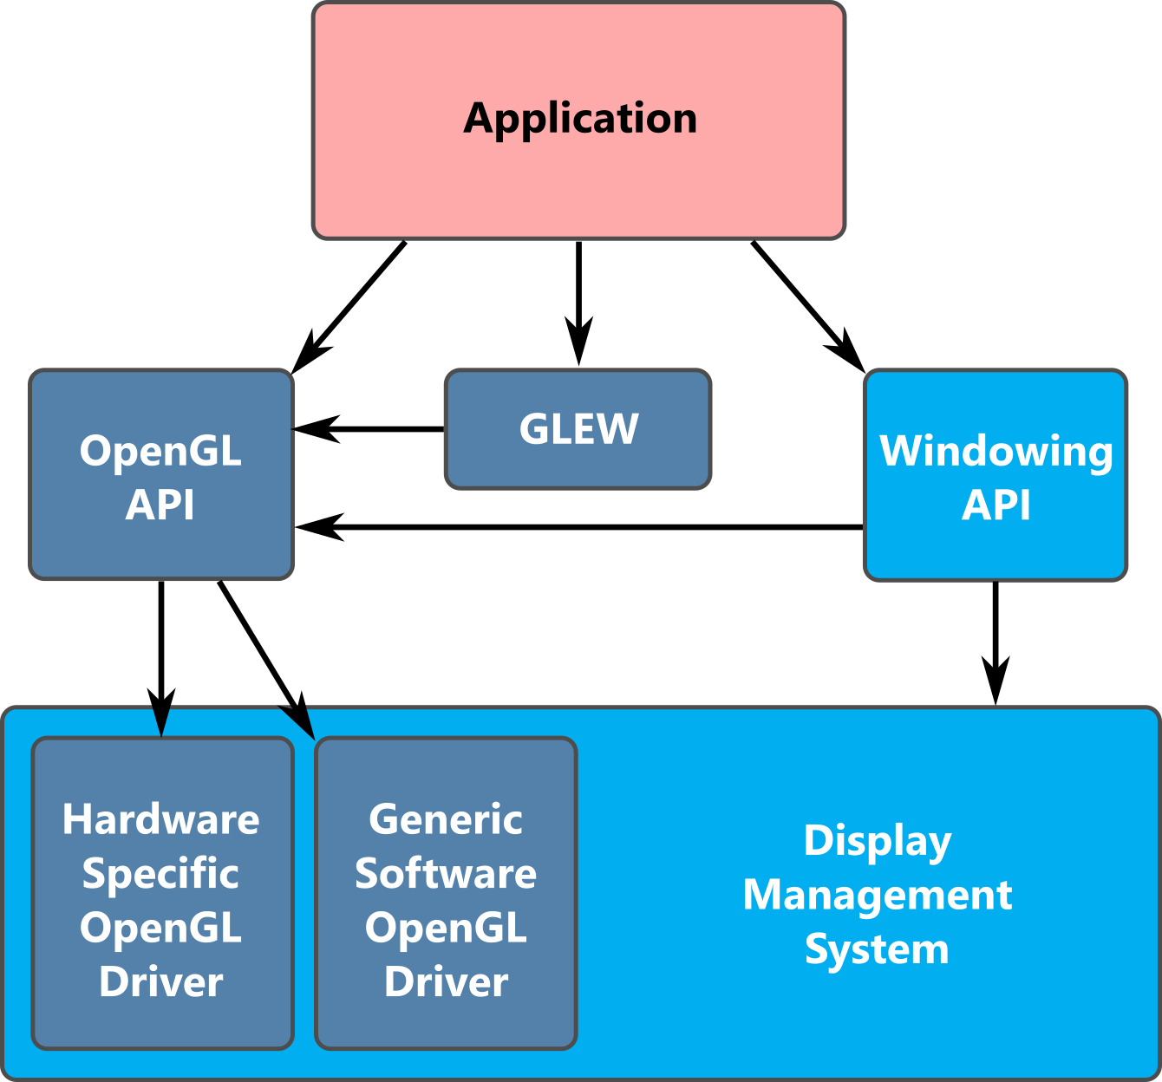
Block diagram of OpenGL
https://www.labs.cs.uregina.ca/315/WebGL2/Lab1/

Slide 9
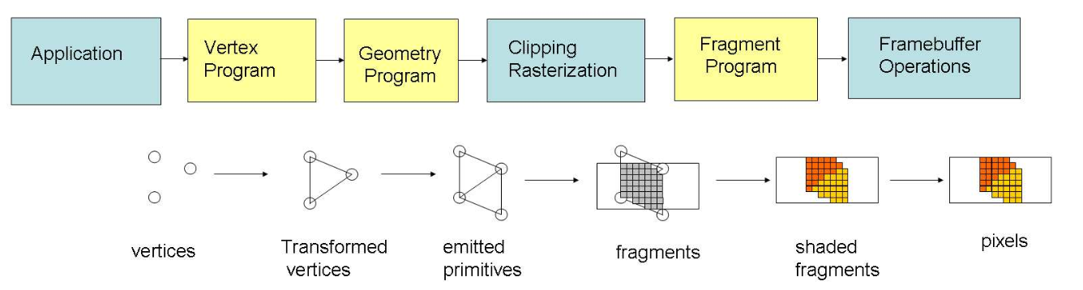
OpenGL pipeline
Non-rigid multi-modal registration on the GPU
March 2007Proceedings of SPIE - The International Society for Optical Engineering

Slide 10

directx
DirectX is a collection of application programming interfaces (APIs) developed by Microsoft. These APIs are specifically designed for handling multimedia tasks, especially game programming and video, on Microsoft platforms like Windows and Xbox.
Focus on Games and Multimedia - DirectX is particularly geared towards the development of video games and other multimedia applications that require high-performance graphics, audio, and input handling.
DirectX Ecosystem - It's not a single API, but rather a suite of several different APIs, each addressing a specific aspect of multimedia functionality. Some prominent examples include:
Direct3D - Handles 3D graphics rendering, a crucial component for modern games.
DirectSound - Deals with audio playback and sound effects.
DirectInput - Provides an interface for handling input devices like joysticks and gamepads.
Hardware Acceleration - DirectX leverages the capabilities of the computer's graphics card (GPU) and sound card for faster processing and smoother performance.
Windows Integration - Being a Microsoft product, DirectX is tightly integrated with the Windows operating system, making it a natural choice for Windows game developers.

Slide 11
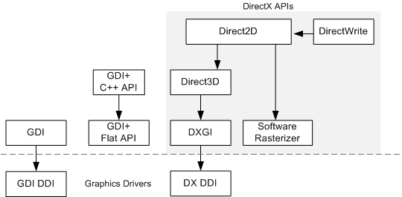
How directx works
https://learn.microsoft.com/en-us/windows/win32/learnwin32/overview-of-the-windows-graphics-architecture

Slide 12

Overview of the Windows Graphics Architecture
Graphics Device Interface (GDI) is the original graphics interface for Windows. GDI was first written for 16-bit Windows and then updated for 32-bit and 64-bit Windows.
GDI+ was introduced in Windows XP as a successor to GDI. The GDI+ library is accessed through a set of C++ classes that wrap flat C functions. The .NET Framework also provides a managed version of GDI+ in the System.Drawing namespace.
Direct3D supports 3-D graphics.
Direct2D is a modern API for 2-D graphics, the successor to both GDI and GDI+.
DirectWrite is a text layout and rasterization engine. You can use either GDI or Direct2D to draw the rasterized text.
DirectX Graphics Infrastructure (DXGI) performs low-level tasks, such as presenting frames for output. Most applications do not use DXGI directly. Rather, it serves as an intermediate layer between the graphics driver and Direct3D.

Slide 13

OpenGL vs DirectX
Similarities
Purpose
Both APIs are designed to render 3D graphics efficiently, allowing developers to create complex scenes and animations.
Functionality
They provide similar core functionalities, including support for 3D models, textures, lighting, and shading.
Performance
Both are capable of high-performance rendering and are used in applications where performance is critical, such as games and simulations.
Hardware Acceleration
They both leverage the capabilities of the GPU to accelerate rendering tasks. They act as intermediaries between a programmer's code and the computer's graphics hardware (GPU), allowing developers to instruct the GPU on how to render graphics.

Slide 14

OpenGL vs DirectX Key differences.
Platform Support
Direct3D - Exclusively available on Microsoft platforms, including Windows and Xbox. It is tightly integrated with the Windows operating system.
OpenGL - Cross-platform, available on Windows, macOS, Linux, and other operating systems. This makes it a popular choice for applications that need to run on multiple platforms.
Development and Management
Direct3D Developed and maintained by Microsoft. Updates and new features are driven by Microsoft’s development schedule.
OpenGL Managed by the Khronos Group, an industry consortium. It has a more open development process with input from various companies and contributors.

Slide 15
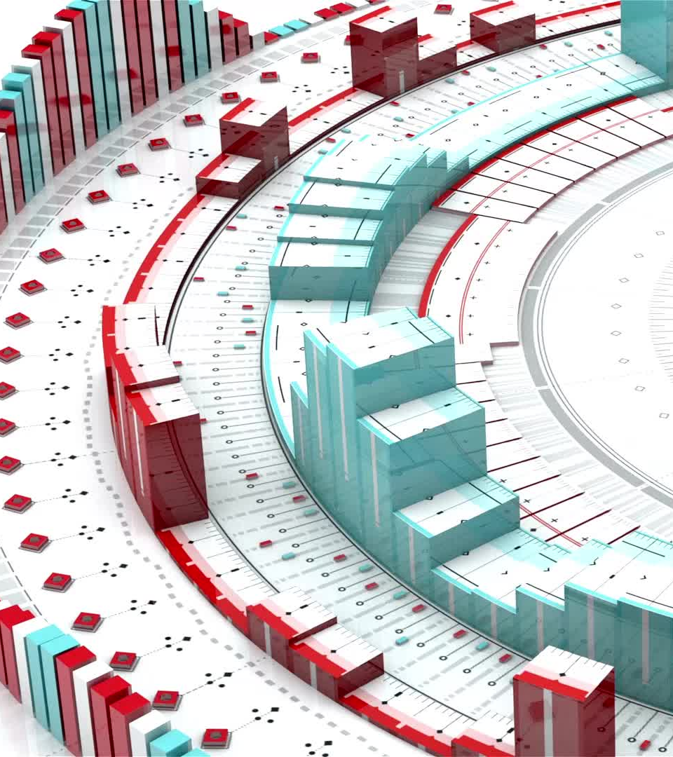
OpenGL vs DirectX
API Design
Direct3D uses a more object-oriented approach with extensive use of COM (Component Object Model) interfaces. It tends to have a steeper learning curve for beginners but offers fine-grained control over rendering.
OpenGL uses a procedural approach with a state machine concept. It is generally considered easier to learn initially but can become complex for more advanced features.
Graphics Pipeline Control
Direct3D provides explicit control over the graphics pipeline, allowing developers to optimize performance more effectively. Direct3D 12, in particular, gives developers lower-level access to GPU resources.
OpenGL, while also offering control over the graphics pipeline, it traditionally abstracts more of the hardware details, which can simplify development but sometimes at the cost of fine-tuned optimization.

Slide 16

OpenGL vs DirectX
Shaders
Direct3D uses HLSL (High-Level Shading Language) for writing shaders.
OpenGL uses GLSL (OpenGL Shading Language) for writing shaders. There are minor syntax and feature differences between HLSL and GLSL.
Community and Ecosystem
Direct3D benefits from strong support within the Windows ecosystem, including robust integration with Microsoft’s development tools and platforms.
OpenGL has a broad community due to its cross-platform nature, with extensive documentation, tutorials, and third-party tools available.

Slide 17
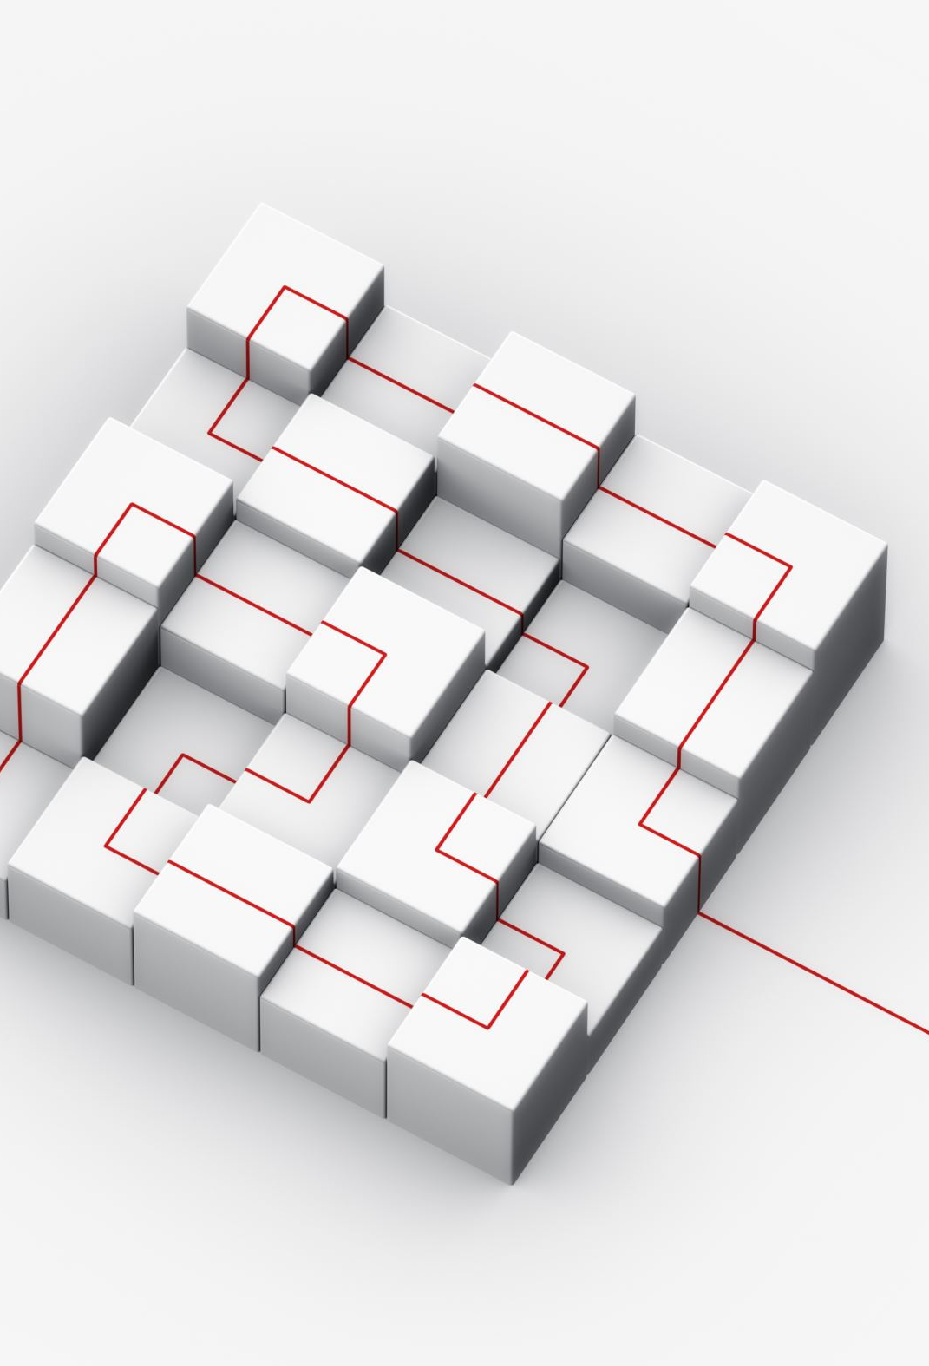
vulkan
Vulkan is a low-level, cross-platform graphics and compute API developed by the Khronos Group, designed to provide more direct control over the GPU and better performance compared to older APIs like OpenGL and Direct3D. It’s particularly suited for applications requiring high efficiency, such as video games, real-time simulations, and high-performance computing.

Slide 18
Key Features of Vulkan
Low-Level Control - Vulkan provides more explicit control over GPU resources and state, allowing developers to optimize performance and memory usage more effectively.
Cross-Platform - Supports a wide range of platforms including Windows, Linux, macOS (via MoltenVK), Android, and more, making it a versatile choice for cross-platform development.
Parallelism - Designed to take full advantage of multi-core processors, Vulkan allows multiple threads to perform rendering operations simultaneously, improving performance on modern hardware.
Explicit API - Unlike OpenGL’s state machine approach, Vulkan requires developers to manage GPU resources and synchronization explicitly. This can lead to better performance but also requires more detailed management.
Modern Graphics Pipeline - Vulkan supports modern GPU features like compute shaders, advanced rendering techniques, and multiple queue submissions, which can be used to achieve high-performance rendering and compute operations.

Slide 19
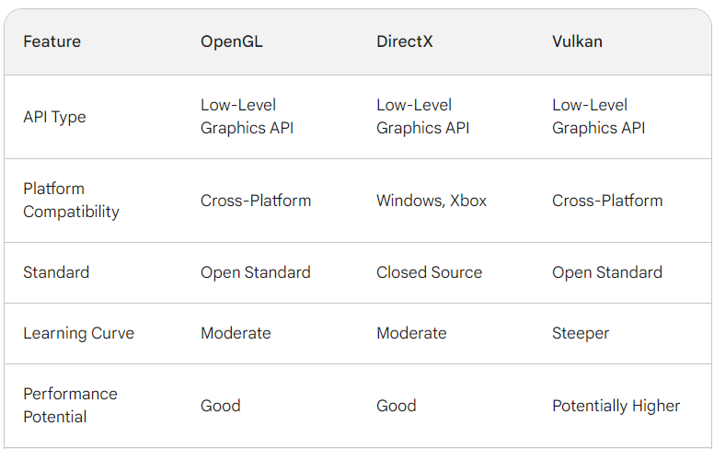
Comparison

Slide 20
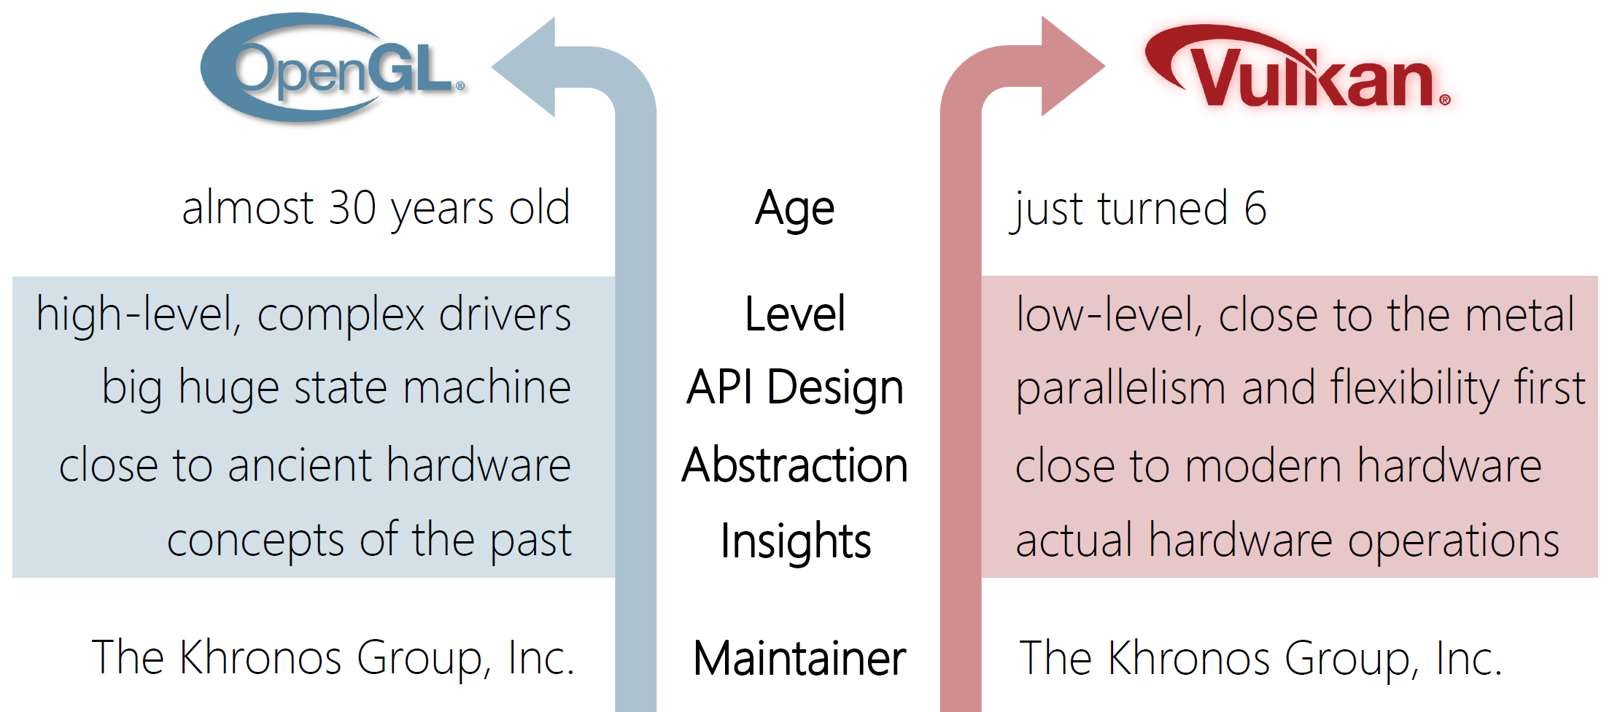
OpenGL vs Vulkan

Slide 21
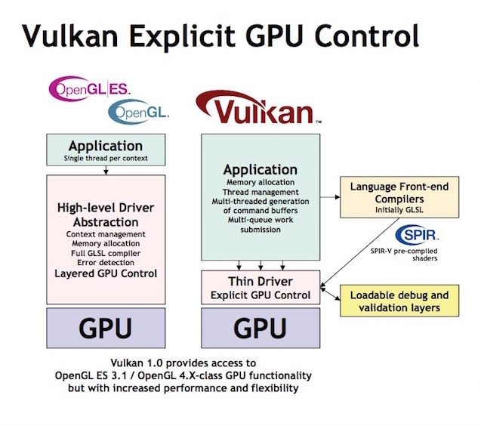
API layer
https://beebom.com/vulkan-api/

Slide 22
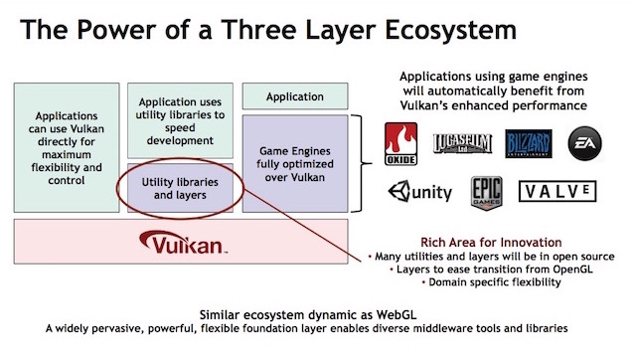
A three-layered API

Slide 23
Vulkan API vs OpenGL ES API
https://developer.arm.com/Additional%20Resources/Video%20Tutorials/Comparison%20of%20Vulkan%20API%20vs%20OpenGL%20ES%20API%20on%20Arm

Slide 24

metal
Metal is a low-level, high-performance graphics and compute API created by Apple. It provides near-direct access to the GPU (Graphics Processing Unit) and is designed to maximize the performance of graphics and compute-intensive tasks on Apple devices.

Slide 25

Metal : Key functionalities
Low-Level Access: Metal provides a low-level API, meaning developers have more control over the GPU hardware compared to higher-level APIs. This can lead to significant performance improvements but also requires more coding effort.
Unified API: Metal is a unified API for graphics and compute operations, meaning it can handle both rendering tasks (like drawing 3D graphics) and compute tasks (like data processing) using the same set of commands. Metal combines functionalities previously found in separate APIs like OpenGL (graphics) and OpenCL (compute) into one. This helps streamline the development process.

Slide 26

Metal : Key functionalities
Platform-Specific: Metal is available on Apple's platforms, including iOS, macOS, tvOS, and watchOS. It is optimized for Apple’s hardware, making it a powerful tool for developers targeting these ecosystems.
Interoperability: Metal works well with other Apple frameworks and technologies, such as Core Animation, Core Image, and ARKit, providing a cohesive development environment.

Slide 27

Metal : Key functionalities
Support for Advanced Graphics Features: Metal supports a wide range of advanced graphics features, including tessellation, multi-threading, and resource heaps, which allow for more complex and visually stunning applications.
Shader Language: Metal includes its own shading language, Metal Shading Language (MSL), which developers use to write shaders that run on the GPU. These shaders can be used for both graphics rendering and compute tasks.

Slide 28
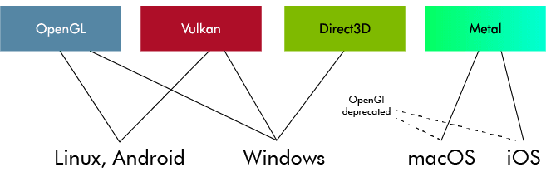
An overview
https://www.artfulbytes.com/bots2d-blogpost

Slide 29
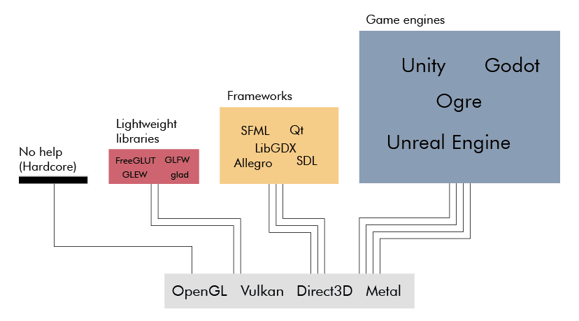
Layers of tools
https://www.artfulbytes.com/bots2d-blogpost

Slide 30

Next … game engine

Slide 31
Game engine
A game engine is a software framework or platform used for the development and creation of video games. It provides a comprehensive suite of tools and features to simplify the game development process, allowing developers to focus more on game design and less on low-level programming. It is basically a toolkit for building video games. Imagine it like a pre-built framework with all the essential components to create a house, instead of having to build every single brick from scratch.

Slide 32
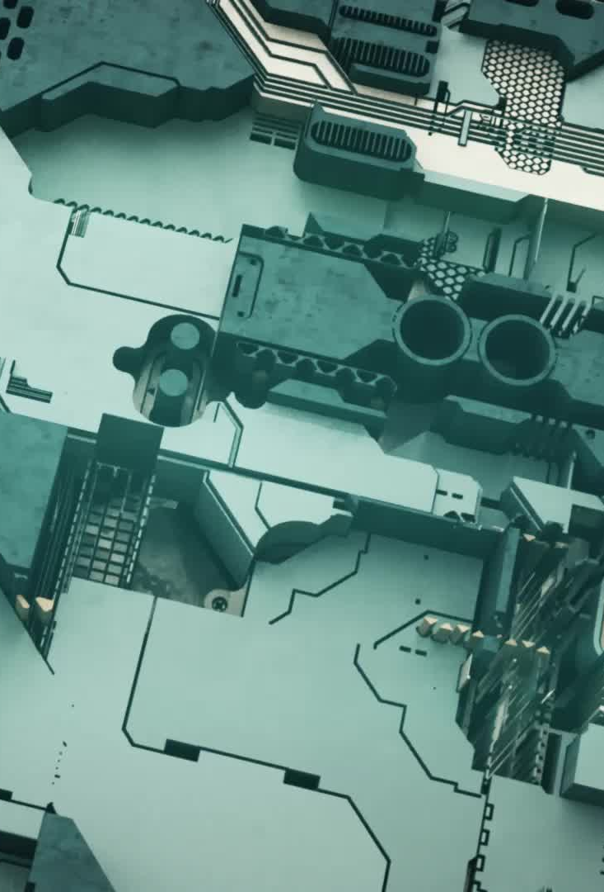
Core components
Rendering engine
Control system
Physics engine
Sound engine
Animation system
Tools – Scripting, User interface (UI), Asset management
Notes:
Rendering Engine:
Handles the drawing of graphics on the screen. This includes 2D and 3D rendering, lighting, shadows, texture mapping, and other graphical effects.
Physics Engine:
Simulates physical interactions in the game world, such as gravity, collisions, and other forces, to create realistic movement and interactions between objects.
Sound Engine:
Manages audio playback, including background music, sound effects, and voice acting. It may also support 3D spatial sound to enhance the gaming experience.
Animation System:
Provides tools for animating characters and objects, including skeletal animation, keyframe animation, and blend shapes.
Scripting:
Allows developers to write game logic and behaviors using scripting languages (e.g., Lua, Python, or custom languages). This makes it easier to implement gameplay mechanics without modifying the core engine code.
User Interface (UI):
Provides tools for creating in-game menus, HUDs (heads-up displays), and other user interface elements.
Asset Management:
Organizes and manages game assets, such as models, textures, audio files, and scripts, ensuring they are efficiently loaded and used within the game.

Slide 33

Why do we use a game engine ?
Faster Development - Compared to building a game from scratch, engines provide pre-built features and tools, saving tons of development time.
Cross-Platform Compatibility - Some engines allow you to develop games for different platforms like PC, consoles, or mobile devices with minimal code changes.
Easier Collaboration - Engines often have large communities and resources available, making it easier for teams to work together on a project.
Quality and Performance - Game engines are optimized for performance and quality, providing advanced features and tools to create high-quality, polished games.

Slide 34

Unreal Engine (UE)
Unreal Engine is a powerful and widely-used game engine developed by Epic Games. It is known for its advanced graphics capabilities, robust feature set, and versatility in creating both 2D and 3D games, as well as other interactive experiences such as virtual reality (VR) and augmented reality (AR) applications.

Slide 35
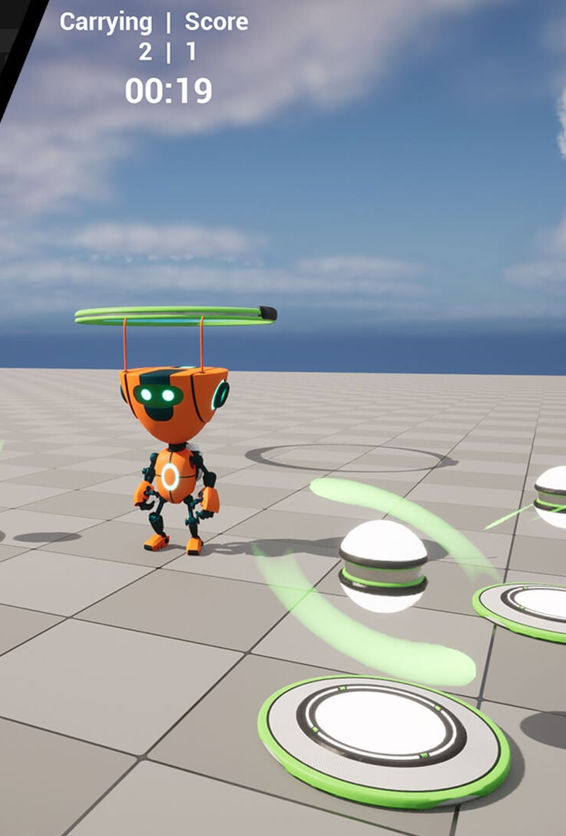
Key features
Game Development - Unreal Engine is particularly renowned for its capabilities in game development. It empowers creators to build stunning visuals with features like high-fidelity graphics, realistic lighting, and physics simulations.
Real-Time 3D Creation - The engine goes beyond games. It's used for creating real-time 3D content for applications like architectural visualizations, product design presentations, and even film and television production with virtual sets.
Strong Feature Set - Unreal Engine comes packed with a comprehensive set of tools, including level editors for designing environments, asset management for organizing game elements, and scripting languages for programming game logic.
Scripting and Programming - Developers can use languages like C++ or Unreal Engine's visual scripting system, Blueprint, to program game logic, character behavior, and artificial intelligence.
Flexibility and Scalability - Unreal Engine is highly flexible and can be used for a variety of applications beyond gaming, including architectural visualization, simulations, film production, and more.

Slide 36
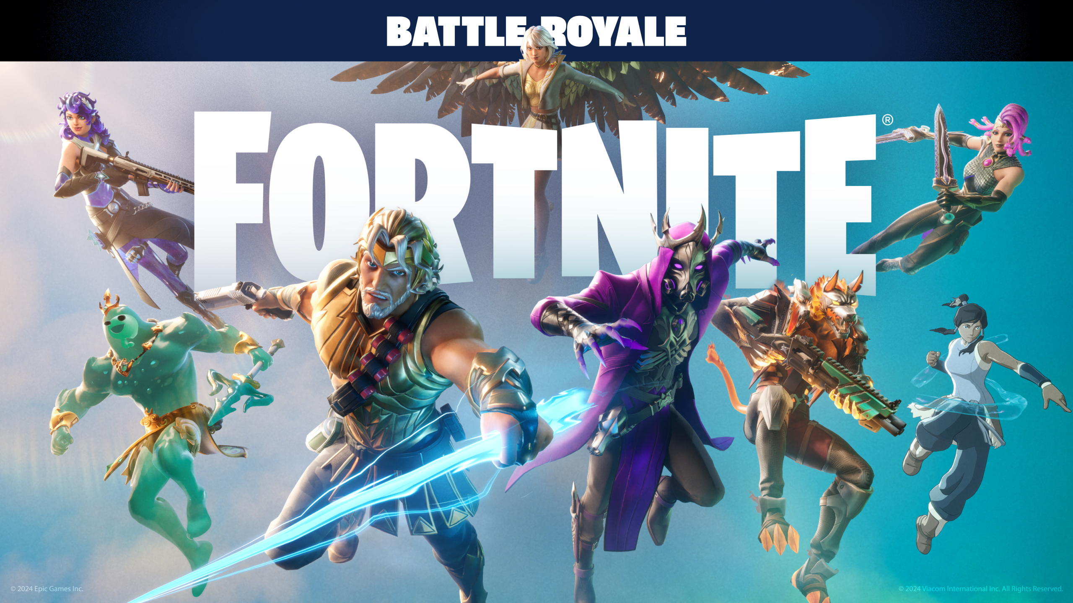


Popular games and applications built with Unreal Engine
Fortnite (Epic Games)
Gears of War series (Epic Games, The Coalition)
BioShock Infinite (Irrational Games)
Batman: Arkham series (Rocksteady Studios)
Final Fantasy VII Remake (Square Enix)
Star Wars Jedi: Fallen Order (Respawn Entertainment)

Slide 37

UE in actions
https://www.youtube.com/watch?v=EYpqY5GumrQ

Slide 38

Cinematic creation
https://www.youtube.com/watch?v=BaoTxLLy_oQ

Slide 39

unity
Unity is a versatile and widely-used game engine developed by Unity Technologies. It is known for its ease of use, cross-platform capabilities, and a robust set of features that make it suitable for creating both 2D and 3D games, as well as other interactive applications such as virtual reality (VR), augmented reality (AR), simulations, and more.

Slide 40
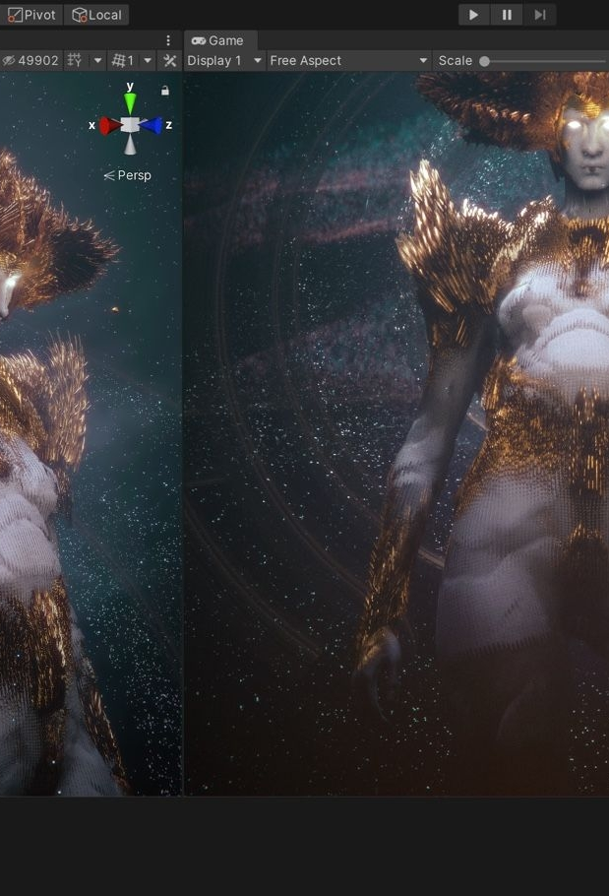
Key features
Beginner-Friendly - Unity's interface and documentation are designed to be approachable for those new to game development.
Cross-Platform Development - Unity supports a wide range of platforms, including Windows, macOS, Linux, iOS, Android, PlayStation, Xbox, Nintendo Switch, WebGL, and more. This makes it easy to develop a game once and deploy it across multiple platforms.
2D & 3D Development - Unity supports both 2D and 3D game development, giving you the flexibility to create various game genres.
VR and AR Support - Unity has extensive support for VR and AR development, providing tools and integrations for a variety of VR headsets and AR devices. This includes support for platforms like Oculus, HTC Vive, Microsoft HoloLens, ARKit, and ARCore.
Large Asset Store - Unity provides a vast asset store where you can purchase pre-made 3D models, textures, code snippets, and other resources to jumpstart your development process.

Slide 41
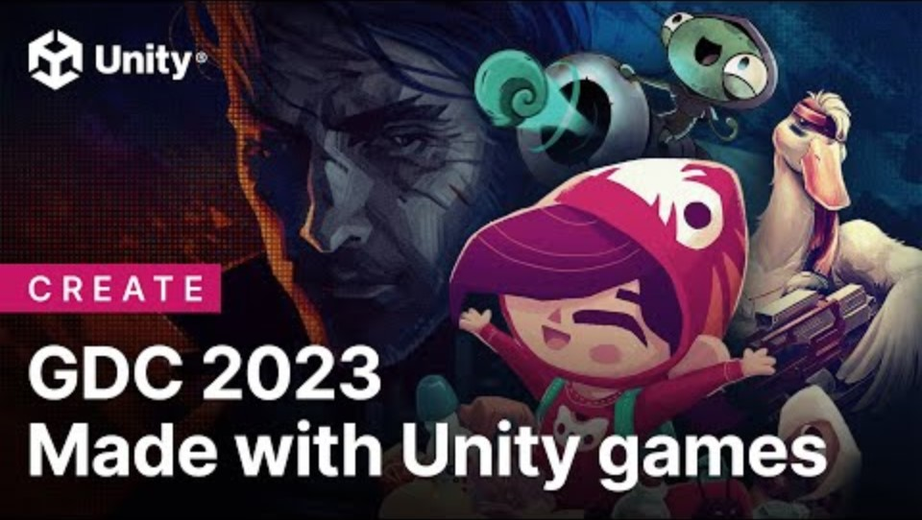
Made with Unity
https://www.youtube.com/watch?v=ucalG1dsvL4

Slide 42
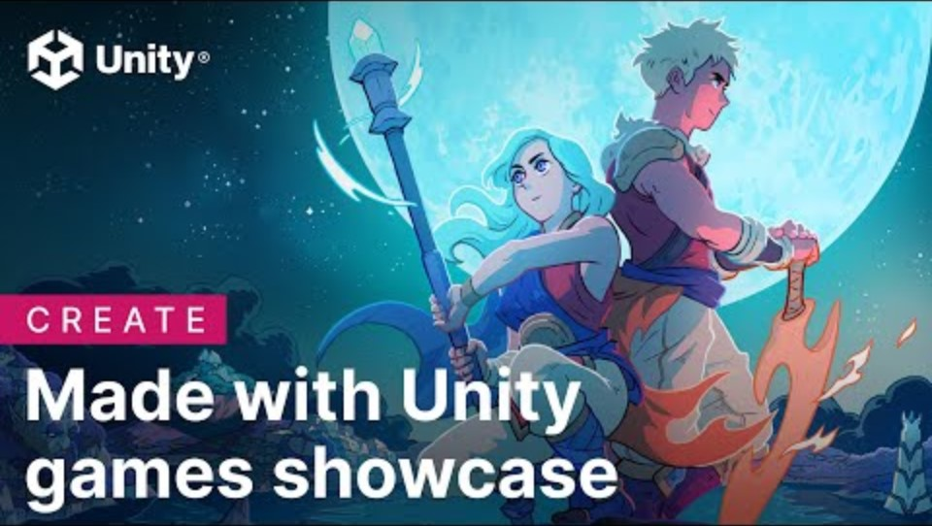
Made with Unity
https://www.youtube.com/watch?v=o35dfdO8WGQ

Slide 43

https://www.youtube.com/watch?v=OxSc-7FIrOQ

Slide 44

https://www.youtube.com/watch?v=oYChsjWQr-A

Slide 45

Graphics libraries on web browsers

Slide 46

WebGL
WebGL (Web Graphics Library) is a JavaScript API used for rendering interactive 2D and 3D graphics within web browsers without the need for plugins. Developed and maintained by the non-profit organization Khronos Group, WebGL is based on OpenGL ES (a subset of the OpenGL API for embedded systems) and provides a powerful and flexible way to leverage the GPU (Graphics Processing Unit) for graphics rendering in web applications.

Slide 47

Key features
Integration with HTML5 - WebGL is fully integrated with HTML5, allowing developers to embed 3D graphics directly within web pages using the <canvas> element. This makes it possible to create rich, interactive graphics and animations in a standard web environment.
Cross-Platform Compatibility - WebGL works across all major web browsers, including Google Chrome, Mozilla Firefox, Safari, Microsoft Edge, and Opera, on various operating systems like Windows, macOS, Linux, Android, and iOS.
Shader Language - WebGL uses GLSL (OpenGL Shading Language) for writing vertex and fragment shaders. These shaders run on the GPU and perform computations for rendering graphics, allowing for highly customizable visual effects and performance optimizations.
Interactivity and Animation - WebGL can be used in conjunction with JavaScript to create interactive and animated graphics. Developers can respond to user inputs, such as mouse movements and clicks, to create dynamic and engaging visual experiences.
No Plugins Required - Unlike older web technologies like Flash or Java applets, WebGL does not require any additional plugins or installations. It is natively supported by modern web browsers, ensuring a seamless experience for users.

Slide 48

example
https://webgl2fundamentals.org/webgl/lessons/webgl-animation.html
https://tsherif.github.io/webgl2examples/particles.html

Slide 49

WebGPU
WebGPU is a modern graphics API designed to provide high-performance, low-level access to the GPU (Graphics Processing Unit) for web applications. It is developed by the W3C (World Wide Web Consortium) and aims to offer more advanced and efficient GPU capabilities than its predecessor, WebGL.

Slide 50

Key features
Low-Level Access - WebGPU provides more direct access to GPU resources compared to WebGL. This allows developers to write more efficient and fine-tuned graphics and compute code, leading to better performance and lower overhead.
Modern Graphics Techniques - WebGPU supports modern graphics APIs and techniques similar to those found in Vulkan, Direct3D 12, and Metal. This includes advanced features such as compute shaders, explicit resource management, and pipeline state objects.
Cross-Platform Compatibility - Like WebGL, WebGPU is designed to be cross-platform, working across different operating systems and browsers. It aims to provide consistent behavior and performance on various devices, including desktops, laptops, and mobile devices.
Compute Shaders - WebGPU includes support for compute shaders, which allow developers to leverage the GPU for general-purpose computing tasks beyond graphics rendering. This is useful for tasks like physics simulations, image processing, and machine learning.
Compute and Graphics in One API - WebGPU integrates both graphics and compute capabilities into a single API, simplifying development workflows and enabling more complex and integrated applications.

Slide 51
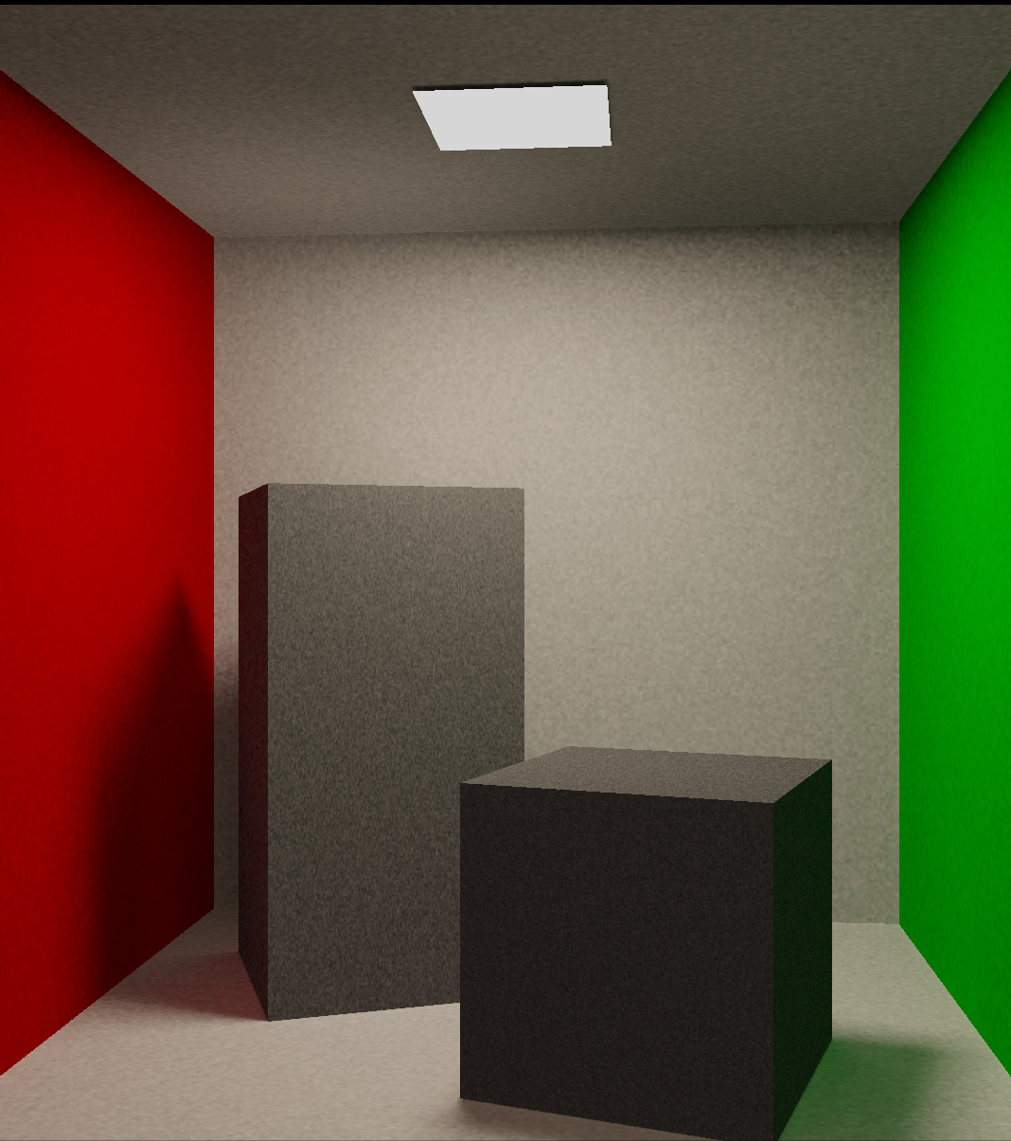
examples
https://webkit.org/demos/webgpu/
https://bevyengine.org/examples-webgpu/

Slide 52

Libraries and frameworks for WebGL and WebGPU
Three.js - A popular JavaScript library that simplifies the use of WebGL by providing an easy-to-use API for creating and managing 3D graphics. Three.js abstracts many of the complexities of WebGL, making it more accessible for developers.
Babylon.js - Another powerful JavaScript framework for building 3D games and applications with WebGL. It provides comprehensive features for creating rich and interactive 3D content.
And many more here - https://gist.github.com/dmnsgn/76878ba6903cf15789b712464875cfdc

Slide 53

examples
https://threejs.org/examples/
https://playground.babylonjs.com/

